Slide 1
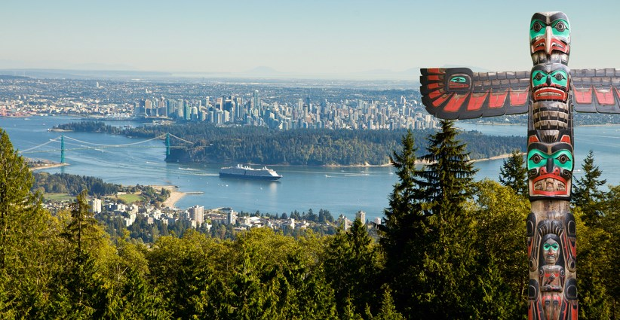
Land acknowledgment
We acknowledge we are on the unceded territories of the xʷməθkʷəy̓əm (Musqueam), Sḵwx̱wú7mesh (Squamish), and Sel̓íl̓witulh (Tsleil-Waututh) Nations.

Slide 2
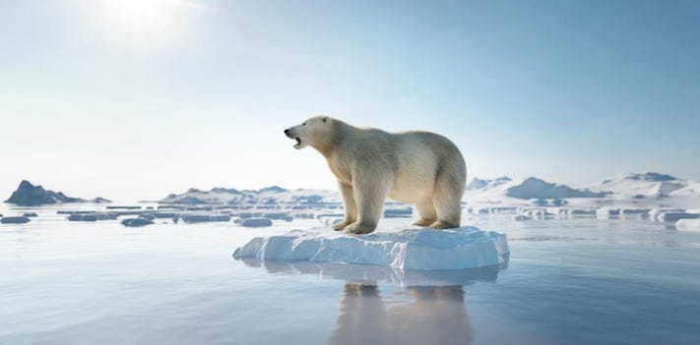

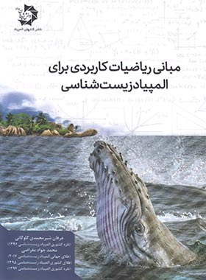
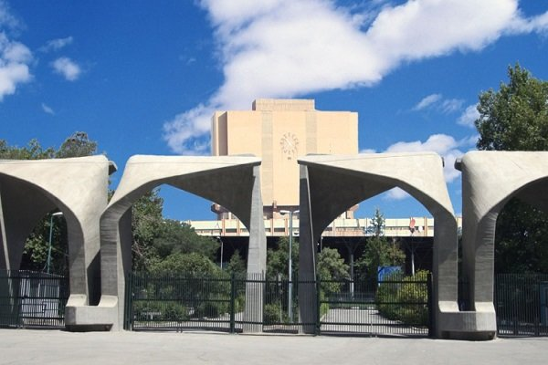
Who am I?

Slide 3
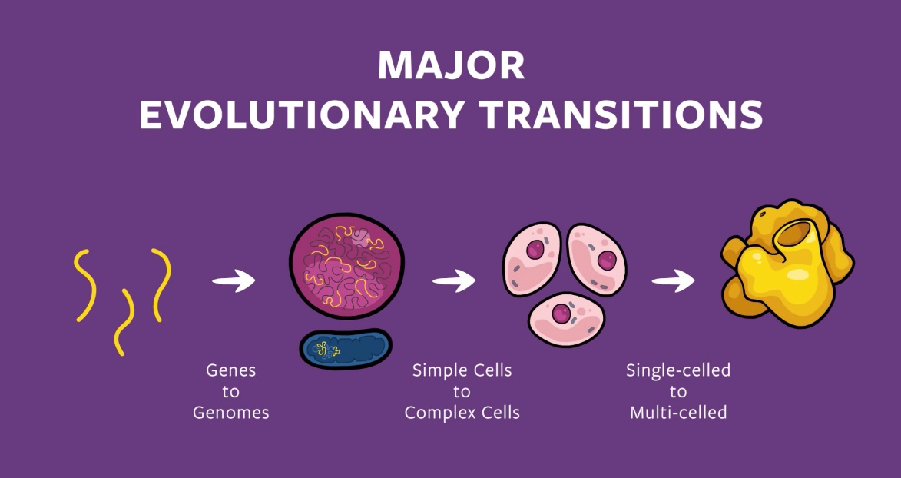
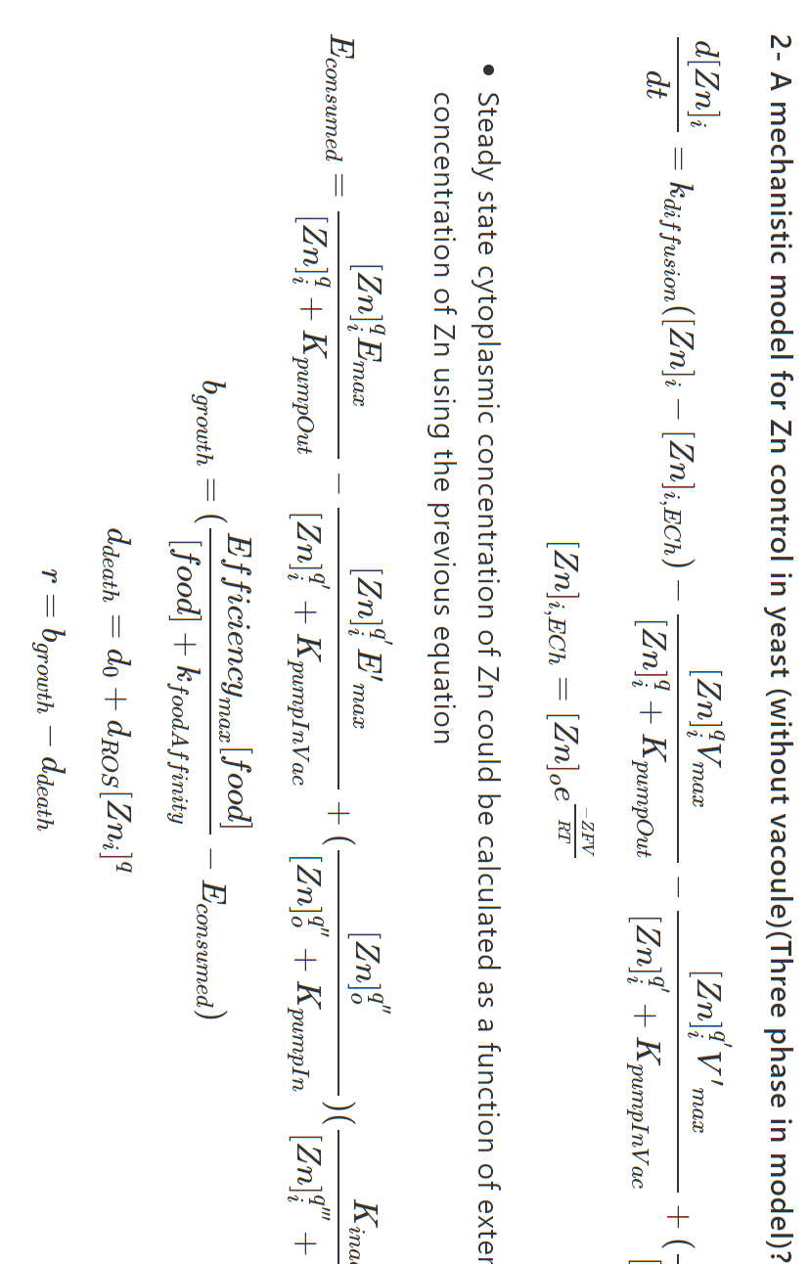
Questions that I am interested in

Slide 4
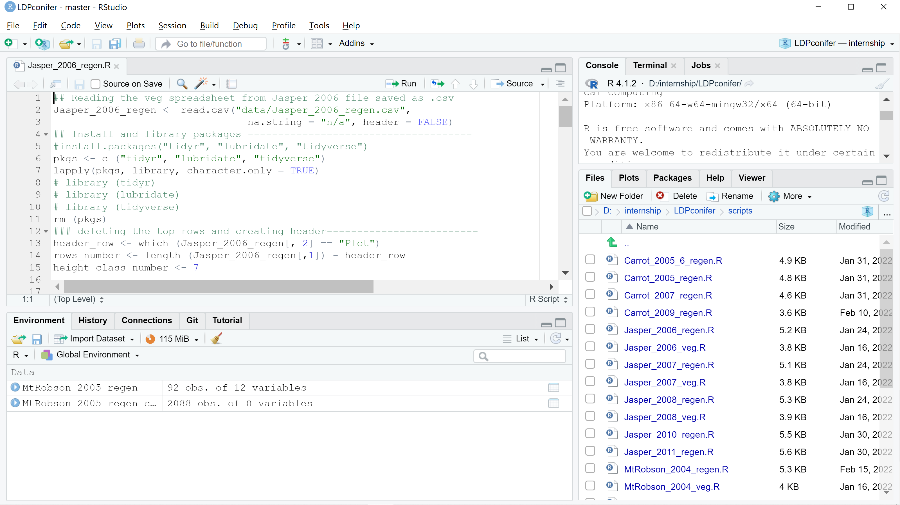
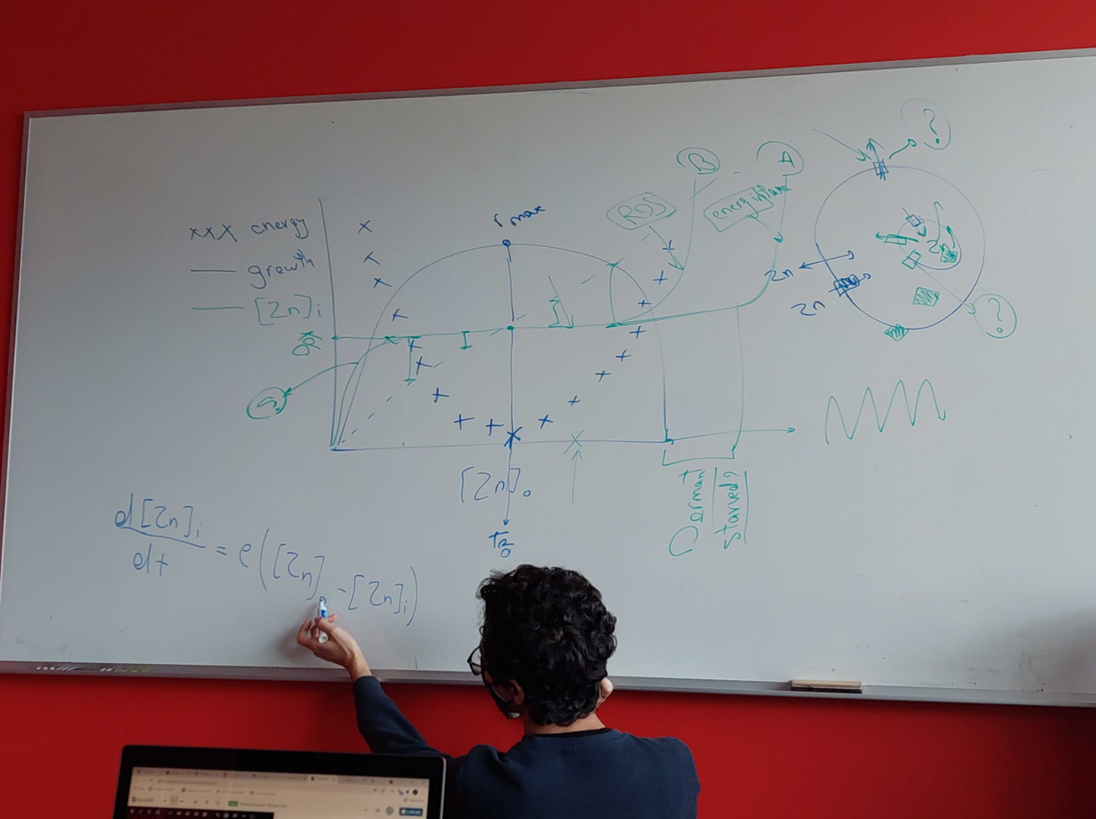
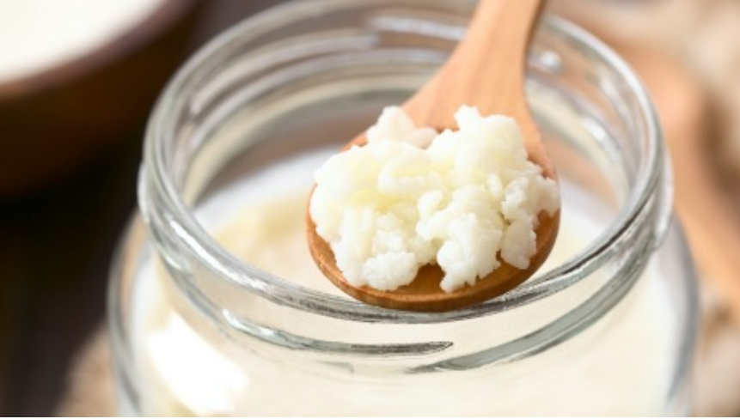
What I have done so far

Slide 5
Why I think Kefir is interesting

Slide 6
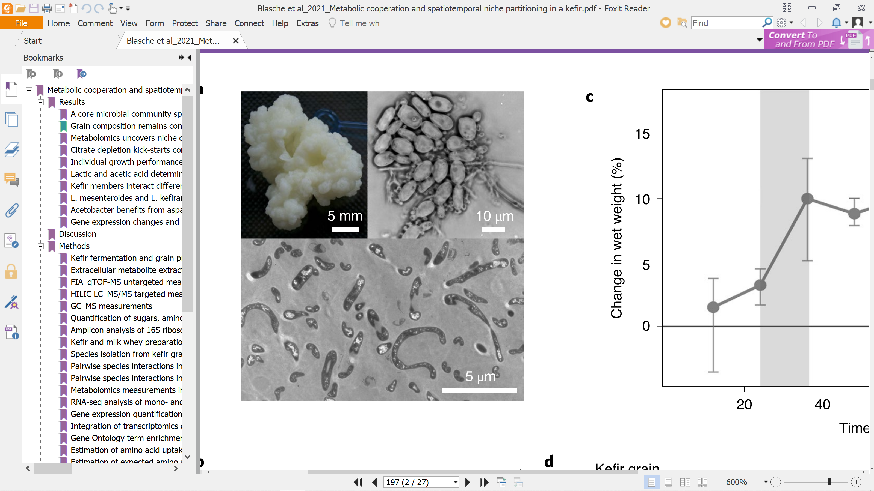

What is Kefir?

Slide 7
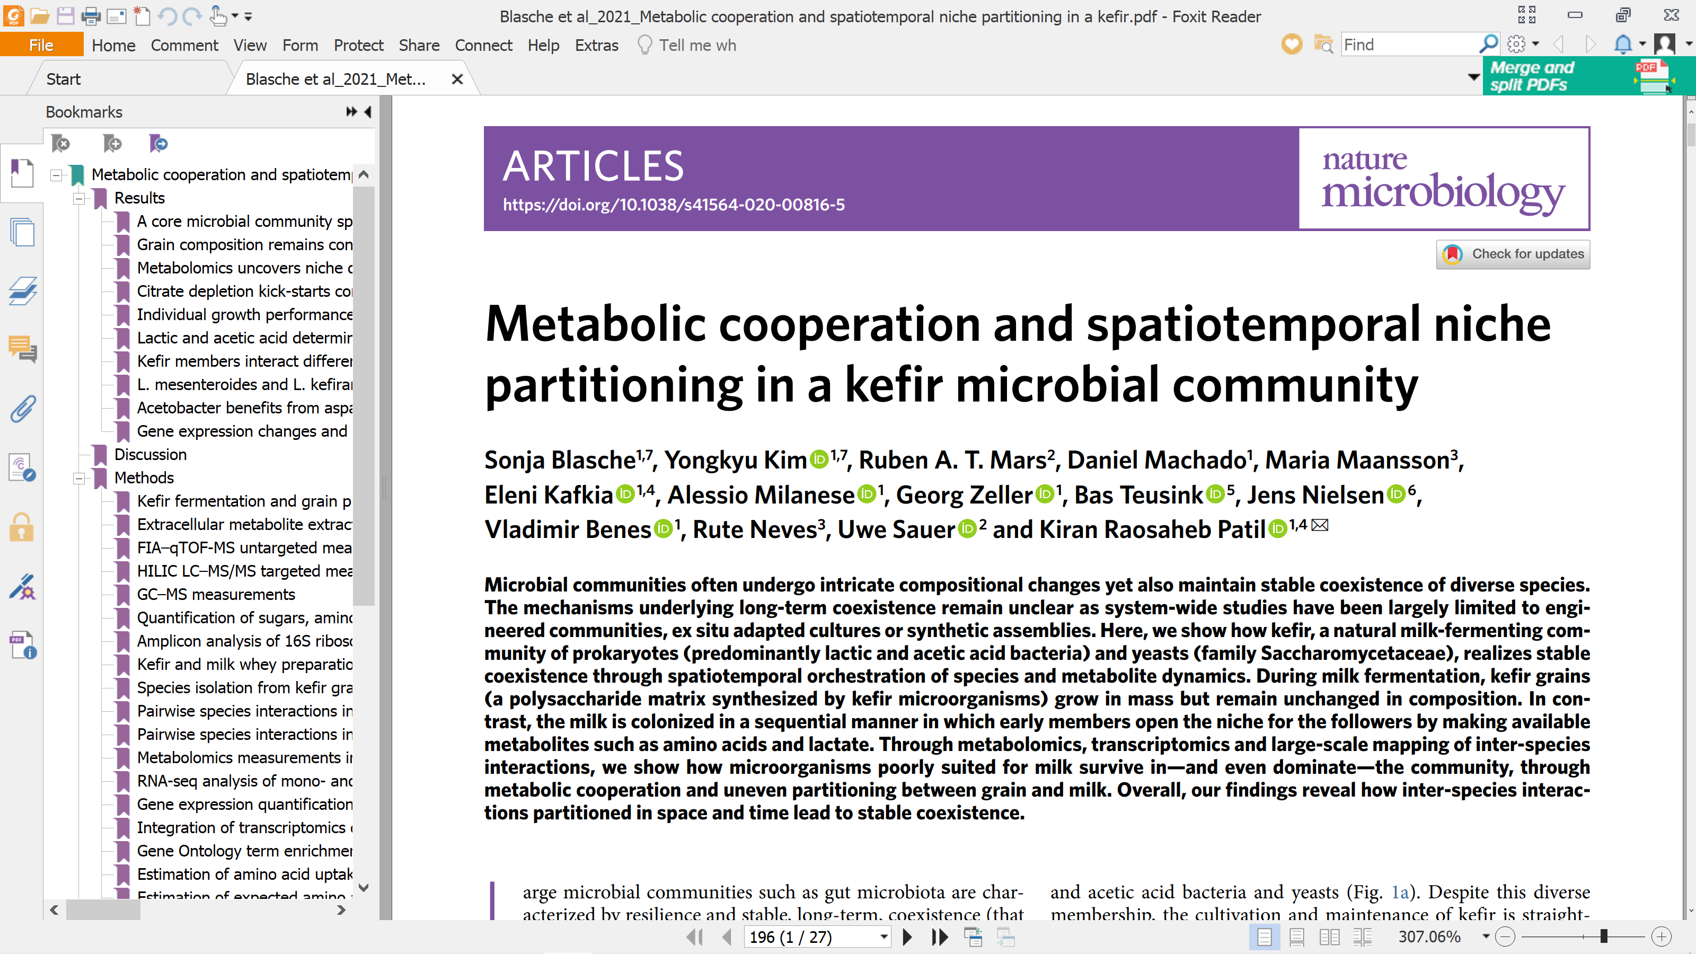
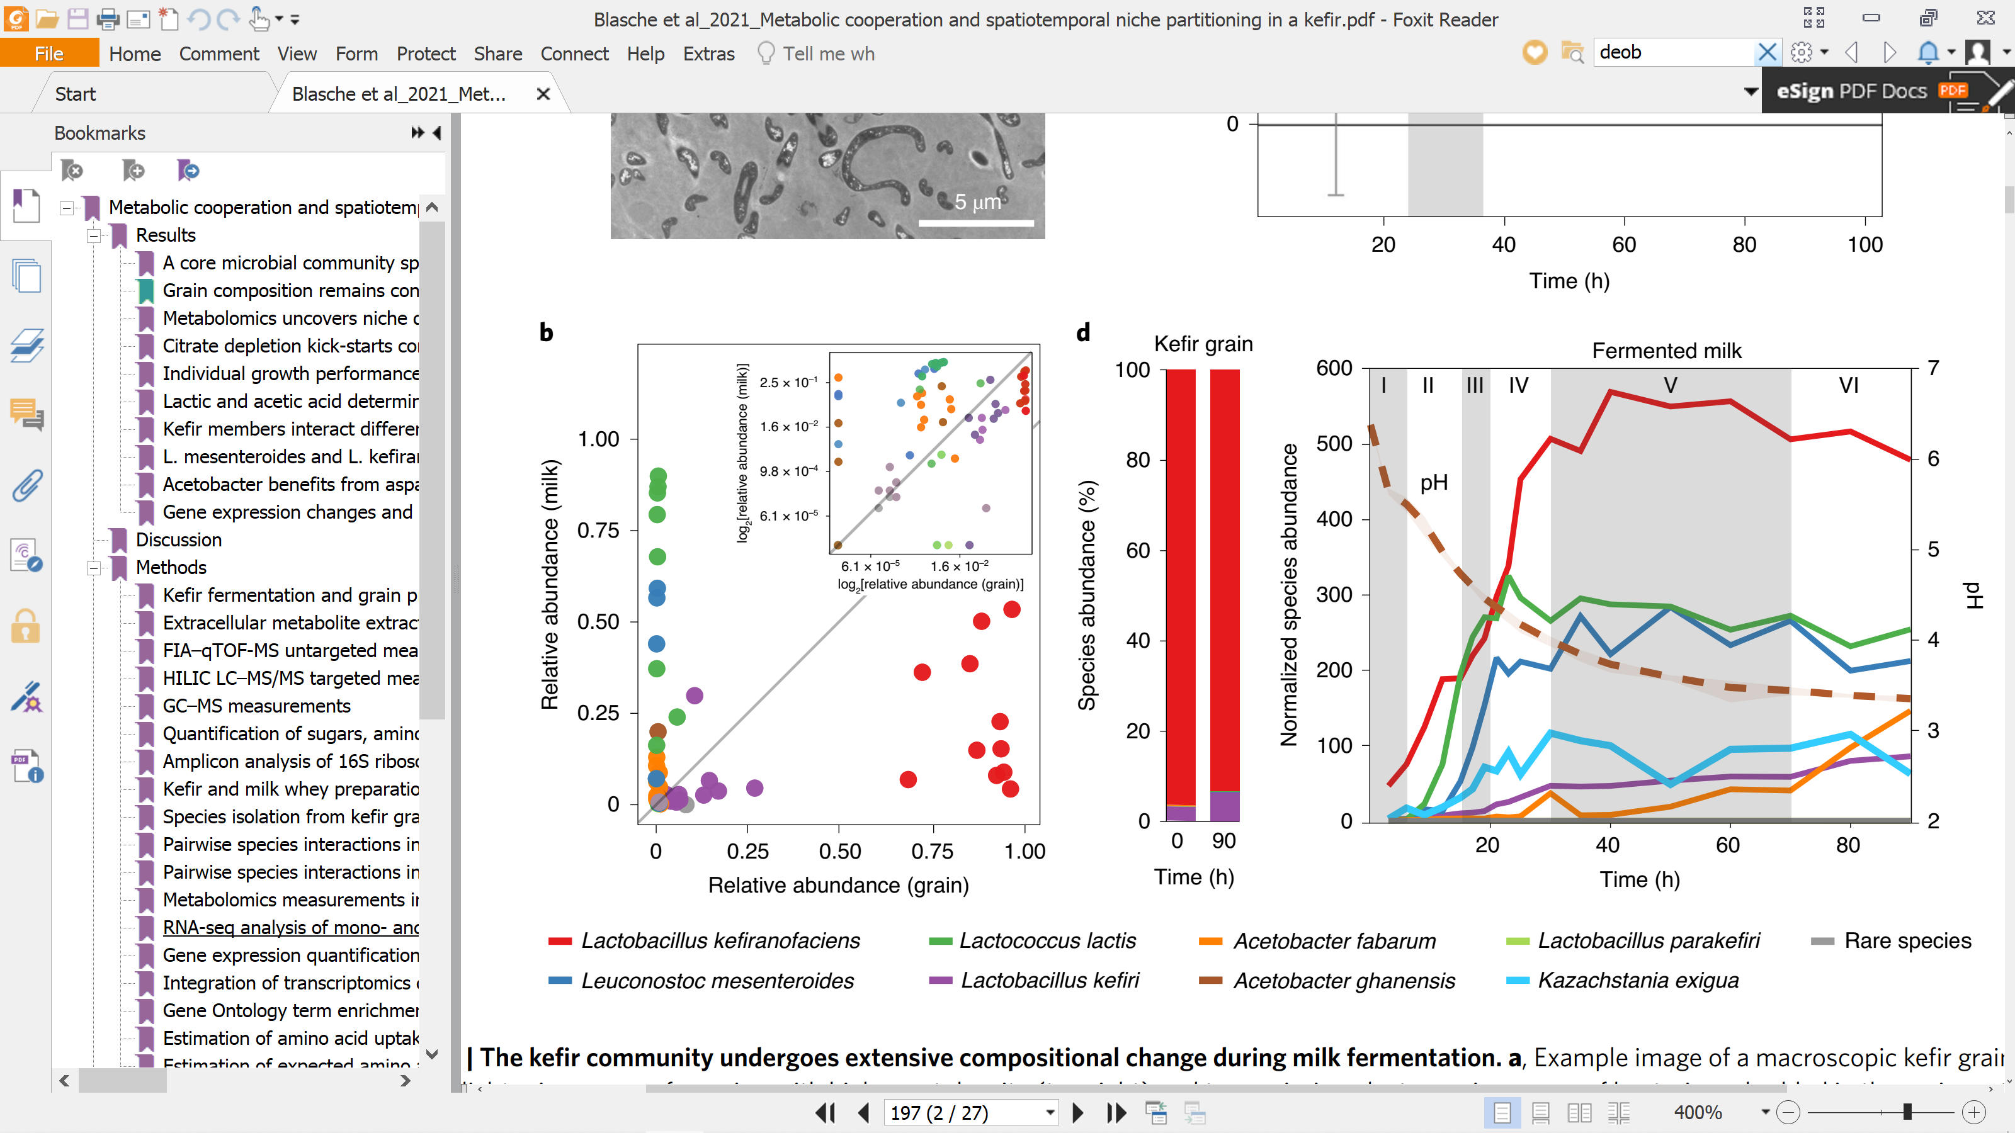
Interesting facts about Kefir

Slide 8
My questions:

Slide 9
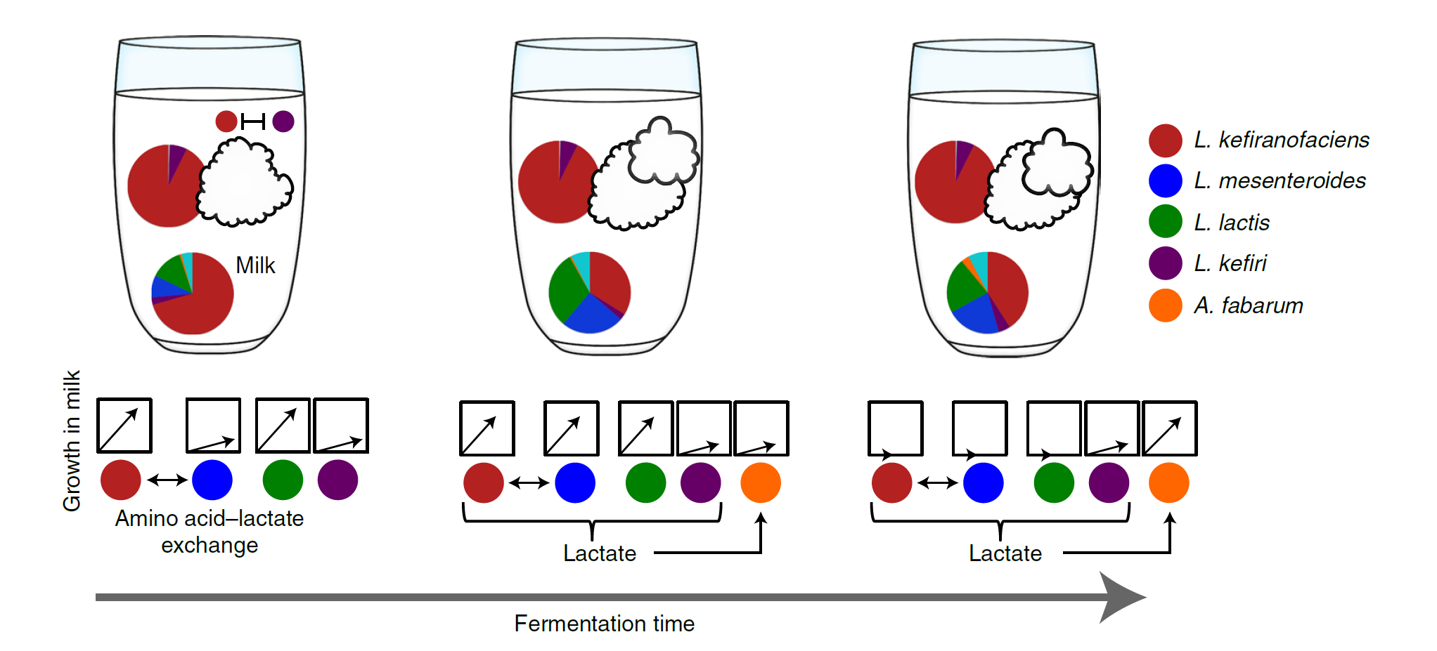
Is Kefir really a superorganism? Or it’s a multicellular LAB with a diffused gut!
Do bacteria that go into milk participate in the formation of new grains? Otherwise they are like somatic cells!

Slide 10
Has group selection played a role in evolution of kefir?
L. Kefirofaciens producing polysaccharide has a benefit. But how they overcome cheaters?
Selection for grain production is probable. Is selection for grain production equivalent of group selection?
Does aggregation provide a framework for group selection?
Interesting fact: LABs and yeasts form aggregation when there is no shaking!

Slide 11
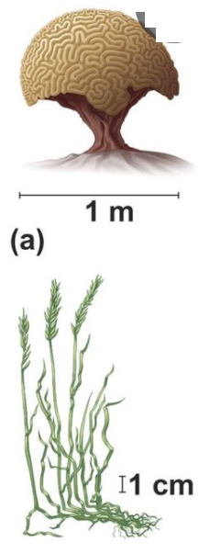
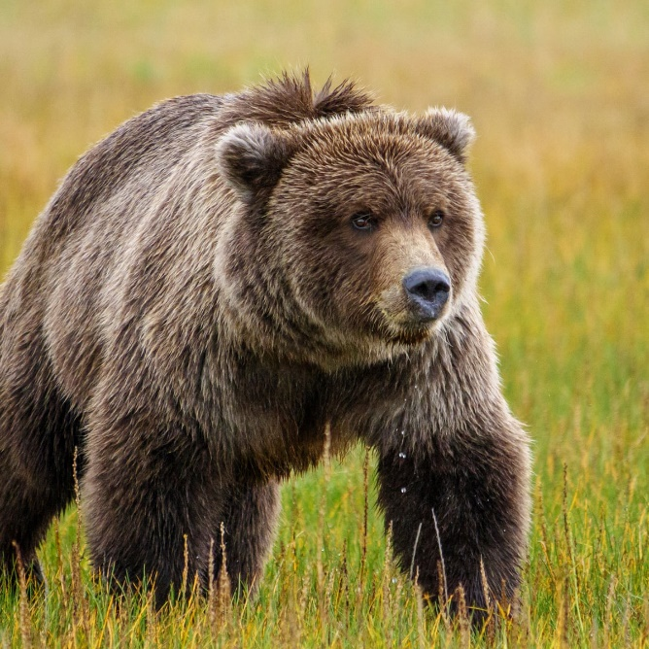
Modular vs Unitary group selection
Are principles of evolution different in Modular vs Unitary Multicellular organisms?
I “feel” that modular structure of kefir has a something to do with evolution of cooperation (in my defense, Lichen is modular)

Slide 12
Kefir patch model
https://shiney.zoology.ubc.ca/wiley/KefirPatchModel/

Slide 13
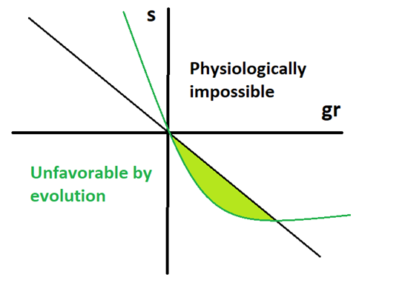
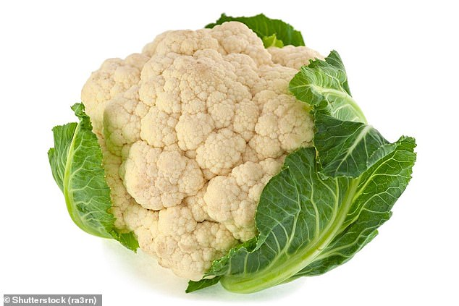
What Kefir patch model tells us about the evolution of cooperation

Slide 14
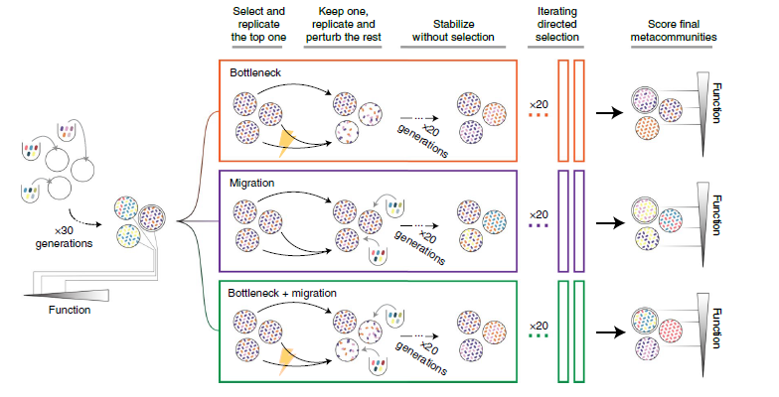

Ecological vs Evolutionary community evolution
Notes:
Community composition is inheritable

Slide 15
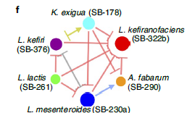
My main question at the moment:
Kefir patch model can make some predictions about how evolutionary forces could be different for different members of community. But How can I incorporate ecological dynamics? What are the important ecological constraints?

Slide 16
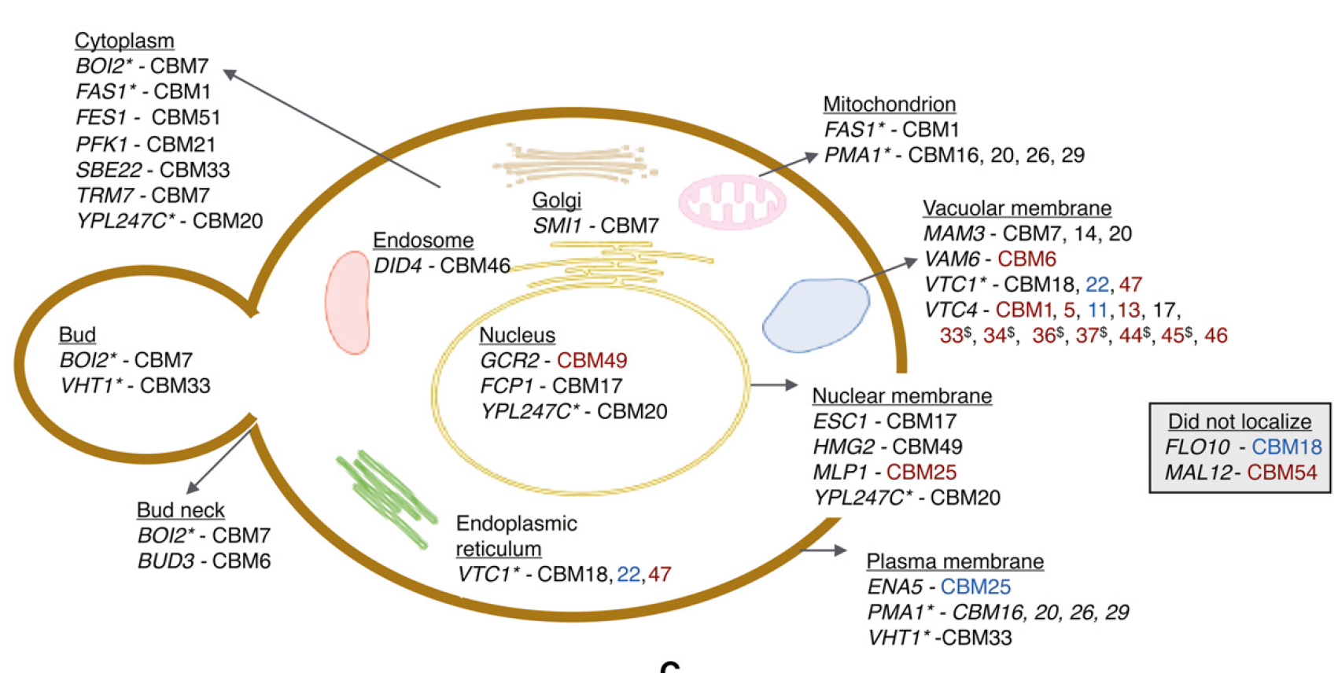
Yeast! My side project

Slide 17
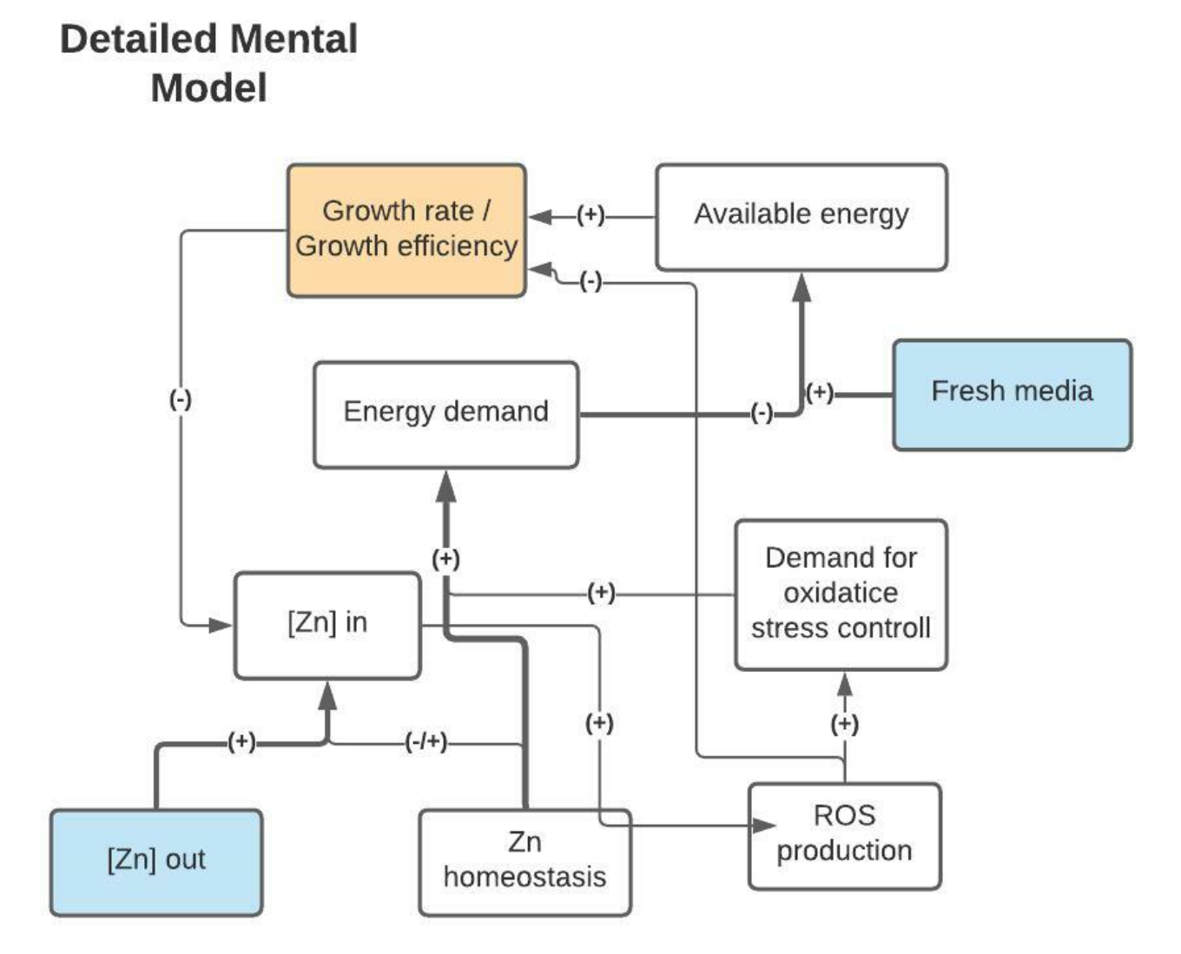
I aim to predict outcomes of evolution
https://hackmd.io/0IcL1GCZSc6NkE7YetmkiA

Slide 18
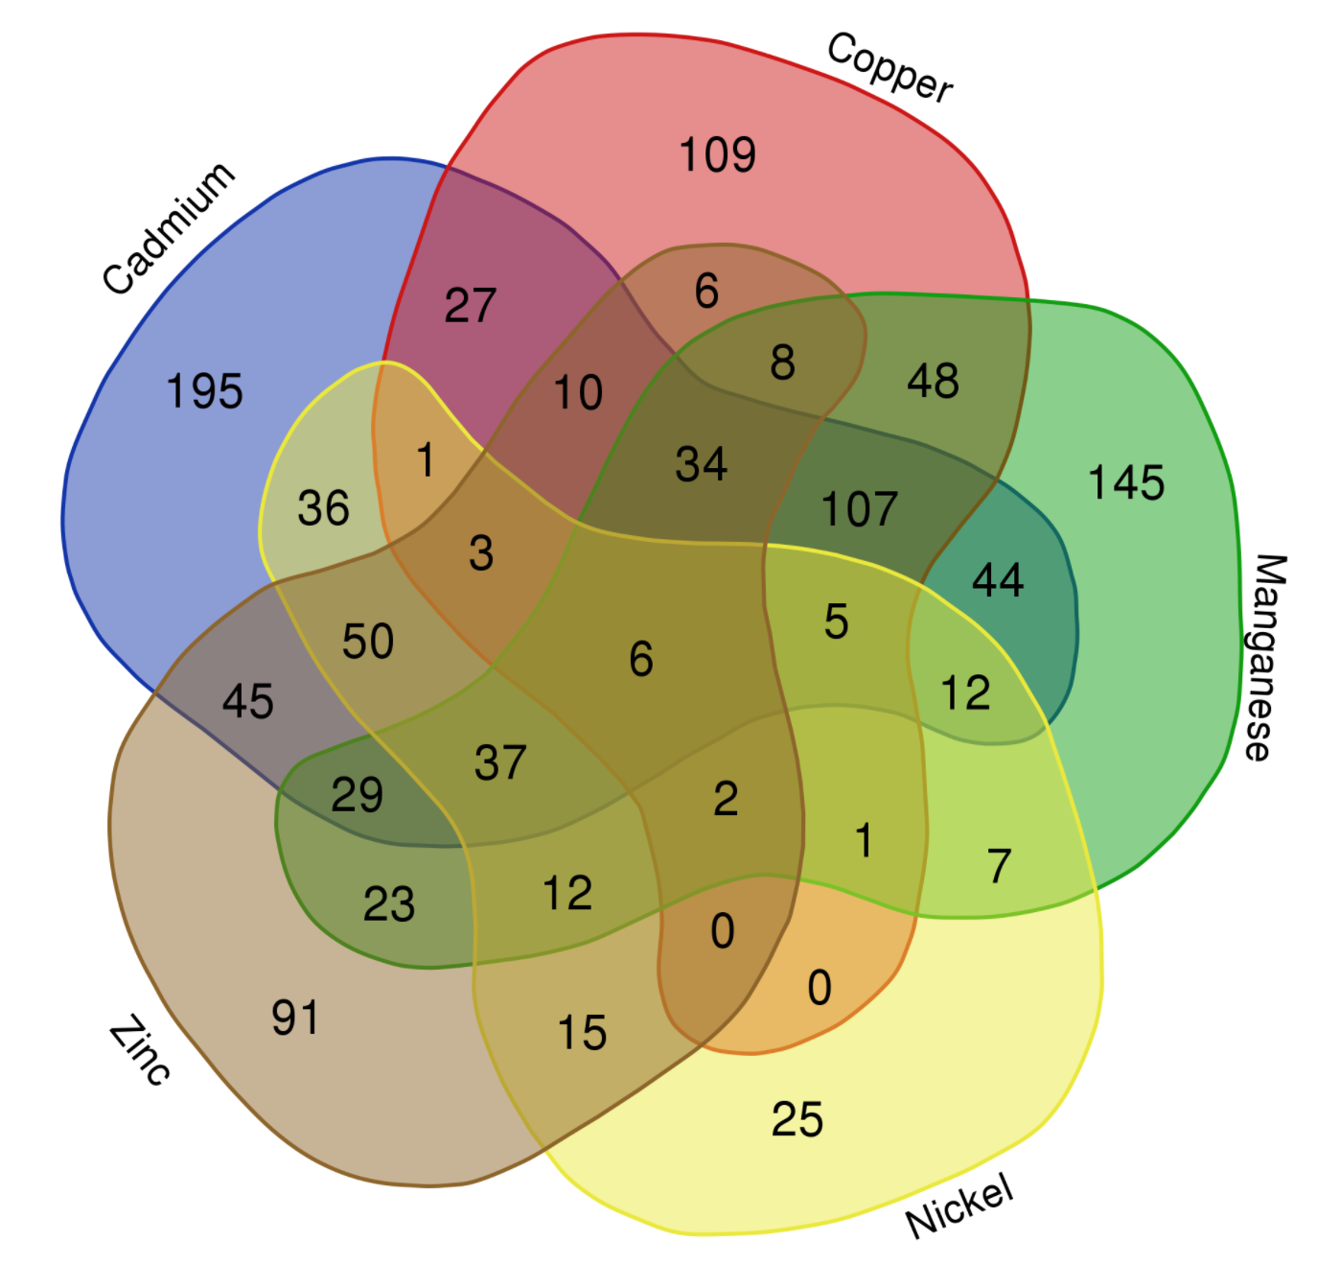
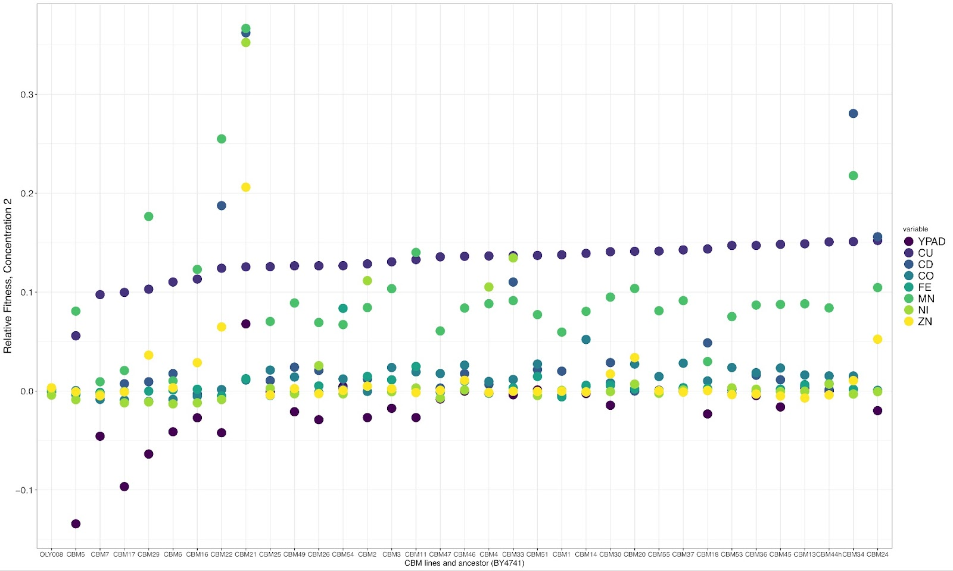
A few interesting patterns

Slide 19


